Slide 1

Company
profile

Slide 2


1 Rehlko company
2 The value of Rehlko
History
Platinum Equity
Rehlko mission and vision
Engines purpose
Leadership team
Global presence
Legendary performance
Focus on the customer
Meaningful product value
Global support
The voice of our customers

Slide 3
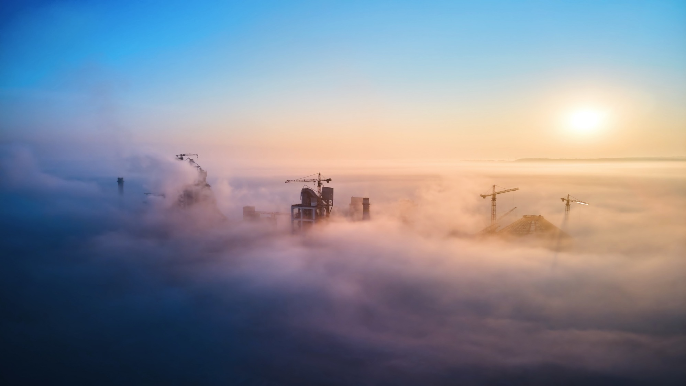


Rehlko company

Slide 4
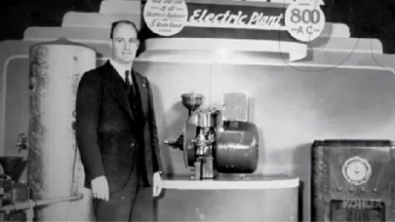
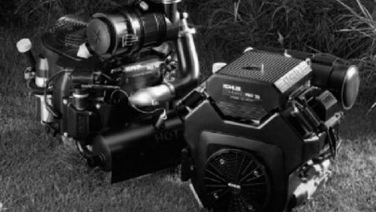

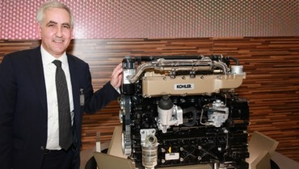
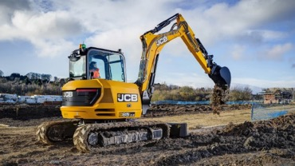
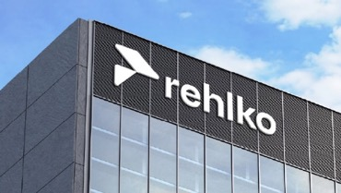
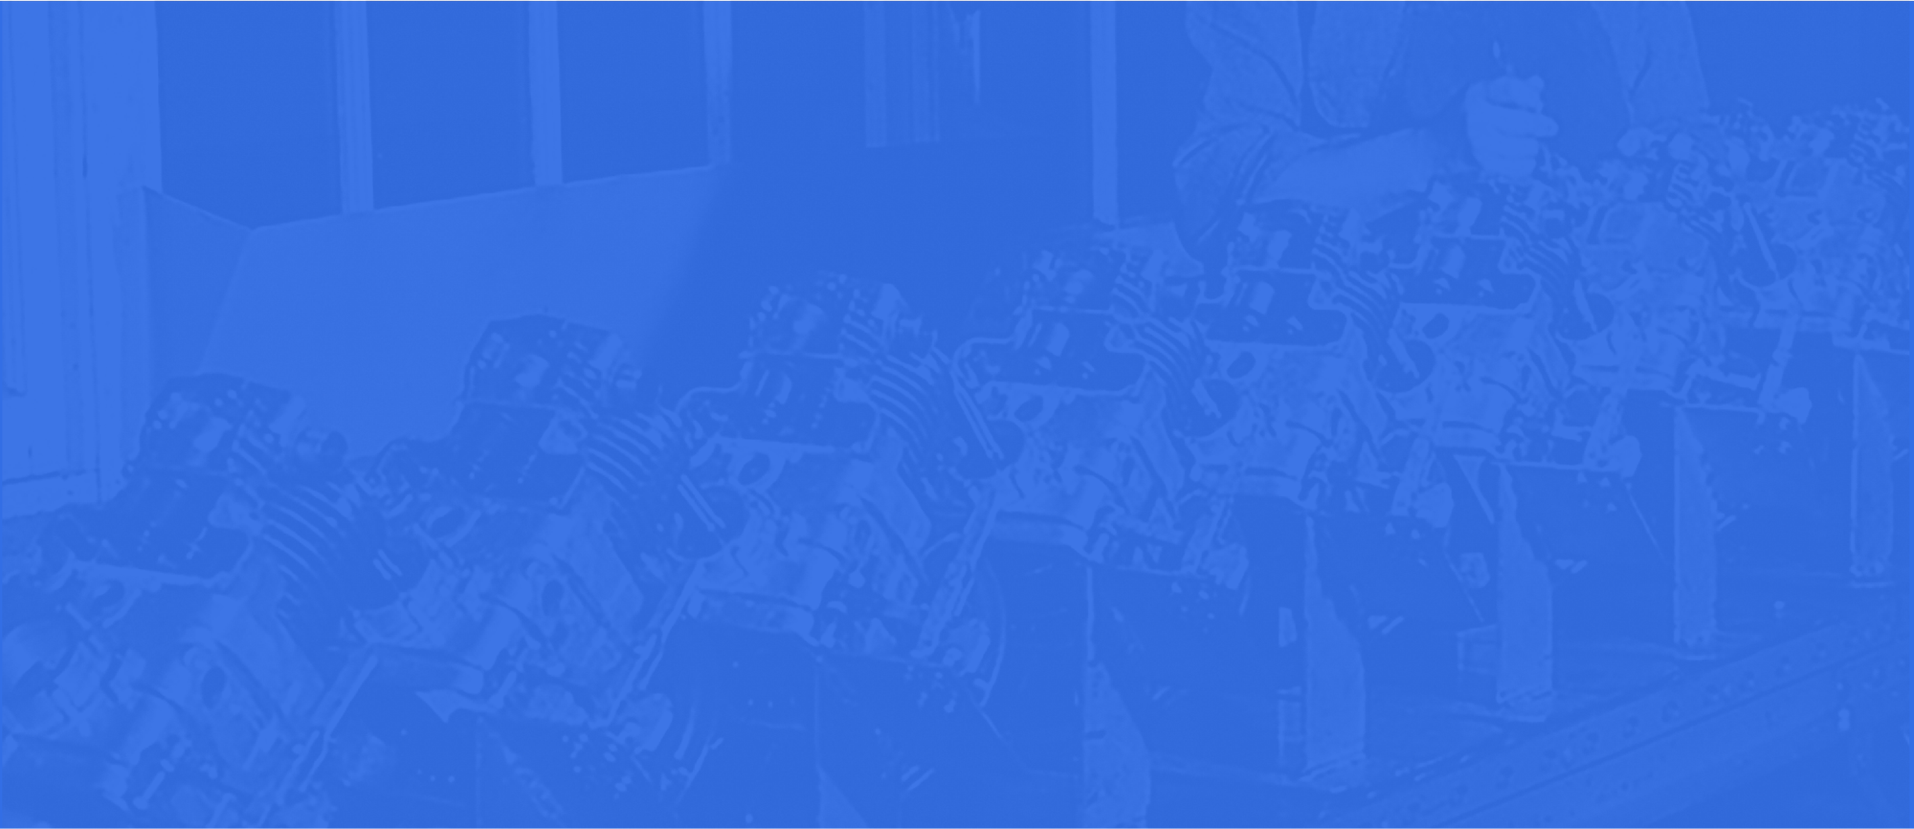
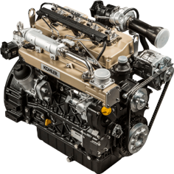


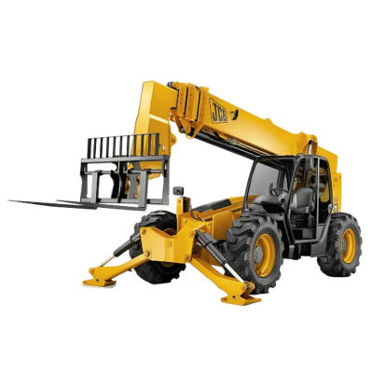
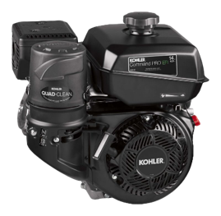


History
More than 100 years of legacy
Kohler enters the power systems market with the world’s first engine-powered electric generator
Sales of small engines to outside customers begins
Industry’s first overhead-valve small engine
Introduced EFI to small engine market
Acquired
Italy-based Lombardini
Launched next generation EFI engines
Launched first KDI engine with JCB
Kohler Energy is now Rehlko
1920
1948
1988
1990
2007
2009
2013
2024
2012
2023
Foundation of Lombardini
in Reggio Emilia, Italy
First Air-Cooled Diesel Engine, particularly popular in agricultural and industrial applications.
Expansion to International Markets, particularly in Europe, Asia, and North America.
Introduction of the KDI Engine Series
Kohler Co. announces the setup of the Energy division as independent business with Platinum Equity as majority investment partner
1933
1963
1970

Slide 5
History
More than 100 years of legacy
Kohler enters the power systems market with the world’s first engine-powered electric generator
Sales of small engines to outside customers begins
Industry’s first overhead-valve small engine
Introduced EFI to small engine market
Acquired
Italy-based Lombardini
Launched next generation EFI engines
Launched first KDI engine with JCB
Kohler Energy is now Rehlko
1920
1948
1988
1990
2007
2009
2013
2024
2012
2023
Foundation of Lombardini
in Reggio Emilia, Italy
First Air-Cooled Diesel Engine, particularly popular in agricultural and industrial applications.
Expansion to International Markets, particularly in Europe, Asia, and North America.
Introduction of the KDI Engine Series
Kohler Co. announces the setup of the Energy division as independent business with Platinum Equity as majority investment partner
1933
1963
1970

Slide 6

About the partner
Platinum Equity is an experienced partner in the industrial products sector with a strong desire to further grow Rehlko and drive value in the category.
Background
Founded in 1995, Platinum Equity is a global investment firm with $48+ billion of assets under management, teams and investors around the world, and a diverse, global portfolio of operating companies in a wide range of industries.
Platinum Equity’s current portfolio of approximately 50 companies operates in a diverse range of industries, generates $90+ billion of aggregate revenue and employs approximately 200,000 people across the globe.

Slide 7
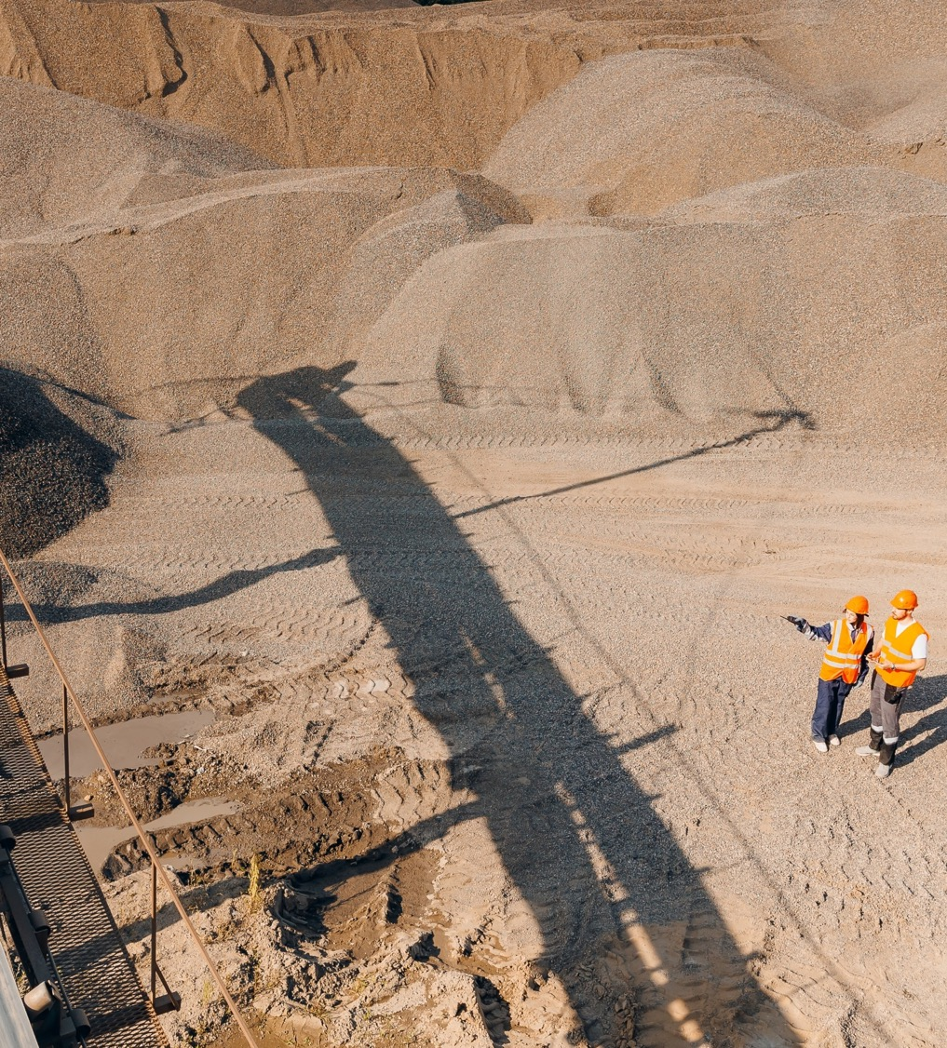

Creating an energy resilient world for a better future
MISSION
Thanks to a diverse portfolio of businesses, including Engines, Power Systems, Home Energy, Kohler Uninterruptible Power, Clarke Energy and the Wilmott Group, Rehlko builds resilience and improves lives and communities, ensuring a more reliable energy future.

Slide 8


For our customers, our solutions are mission critical – they are designed to perform flawlessly. Always.
What does this
mean for Engines?

Slide 9

Our team is always ready – offering exceptional collaborative support, anywhere, anytime, in any way.
What does this
mean for Engines?

Slide 10

For the community, we strive to make the world a better place – by continuously innovating with impactful, sustainable energy solutions that drive positive change.
What does this
mean for Engines?

Slide 11

ENGINES PURPOSE
Empowering our customers to thrive in mission critical situations, delivering unmatched performance anywhere, anytime, in every way.

Slide 12

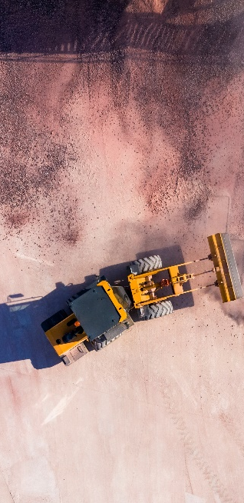
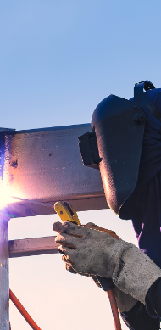

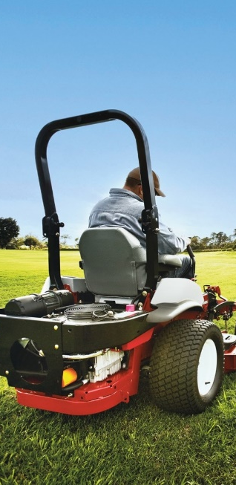
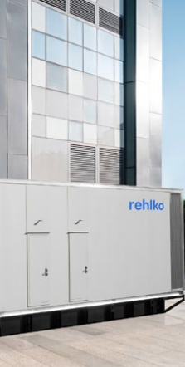


Markets served
Agriculture
Construction
Industrial
Material handling
Turf
Power generation
Marine

Slide 13



Our
values
Curiosity
Trust
Curiosity can unlock opportunities to solve tomorrow’s challenges and to enable our own team to grow
Trust enables us to be confident, own our decisions, and to solve challenges together
Pace
Excellence
Pace and prioritizing helps us make informed choices about the work that matter most
Excellence is the focus that centers our work on finding the win every day
Notes:
Curiosity, Trust, Pace and Excellence are more than just principles for all of us – they are pillars that have supported the company’s century-long legacy of empowering clients and delivering unmatched performance.
These values resonate with Rehlko’s history of passion and dedication showcased in the legacy slide.
Rehlko ensures that its employees are equipped not just to meet challenges but overcome them with innovation and confidence.
By fostering an environment where Curiosity sparks Innovation, Trust builds confidence, Pace prioritizes focus and Excellence drives results, Rehlko continues to fulfill it’s promise to be a reliable partner in mission-critical situations.
This framework connects seamlessly with the company’s overarching commitment to be a partner that clients can rely on anytime, anywhere.
And now, I’d like to hand over to Alice Magnani

Slide 14

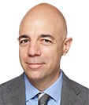
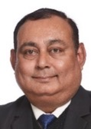
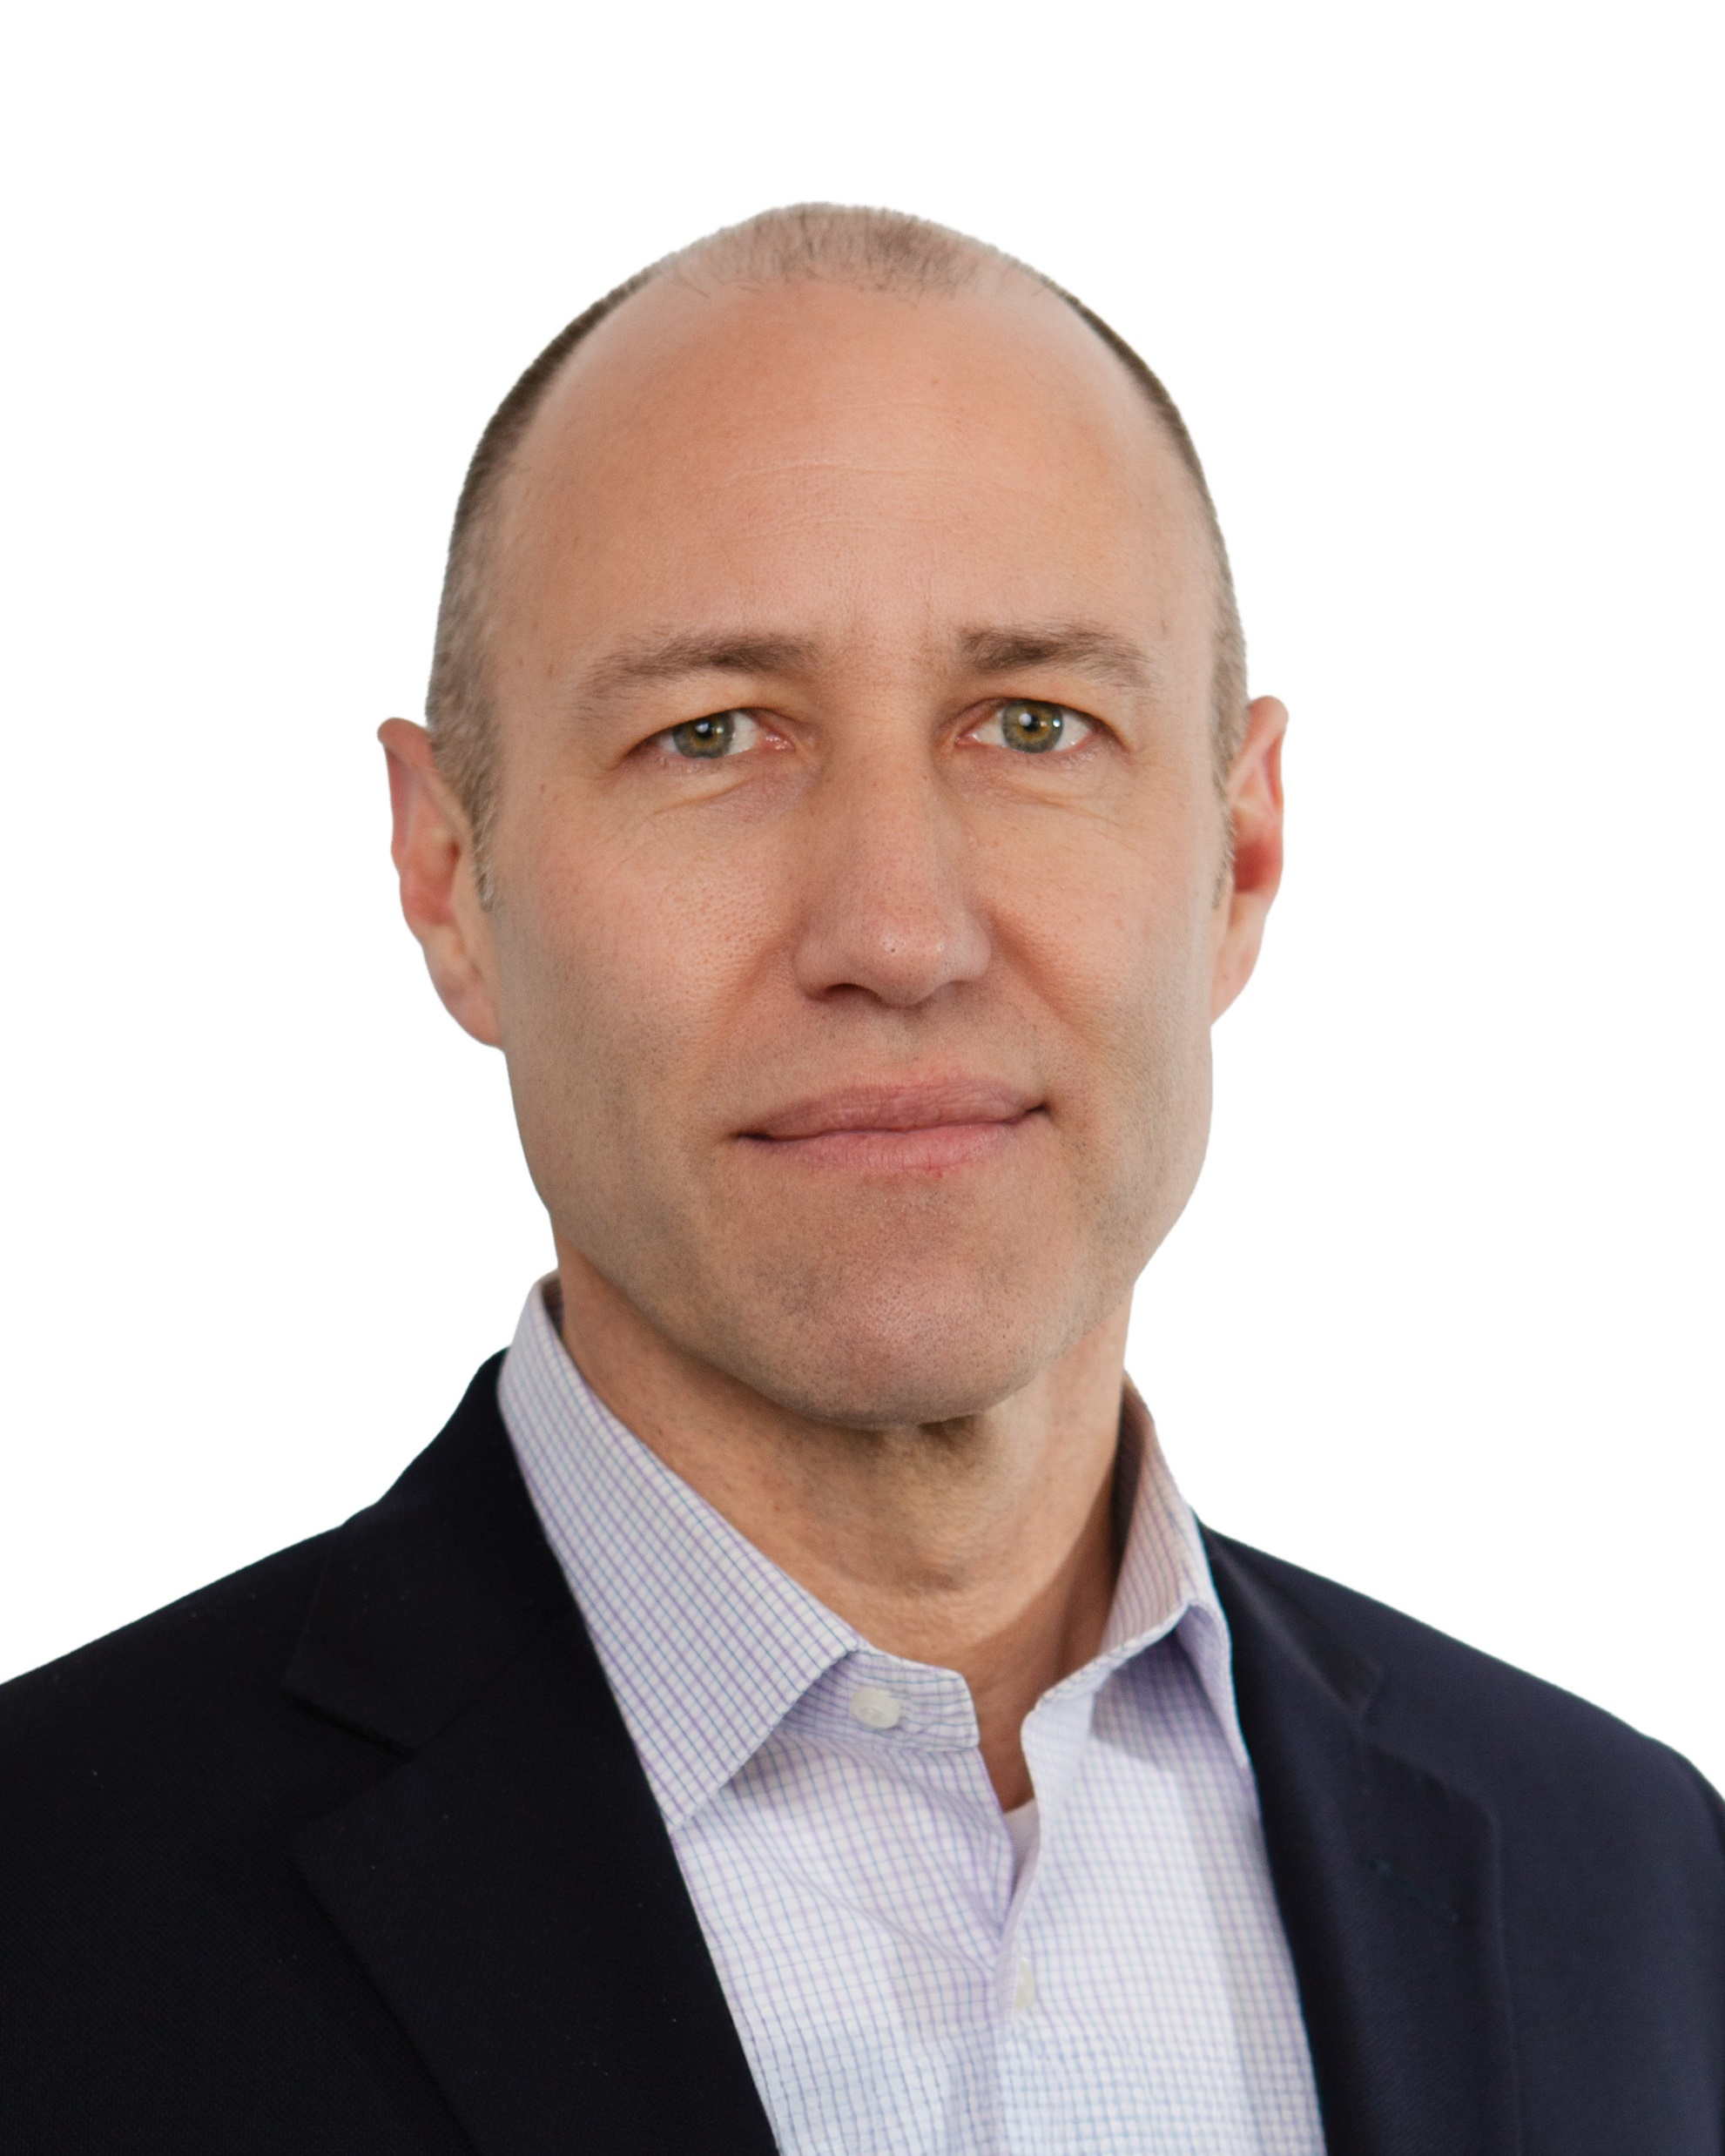
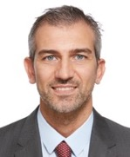
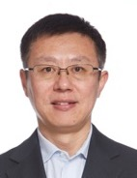
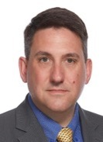
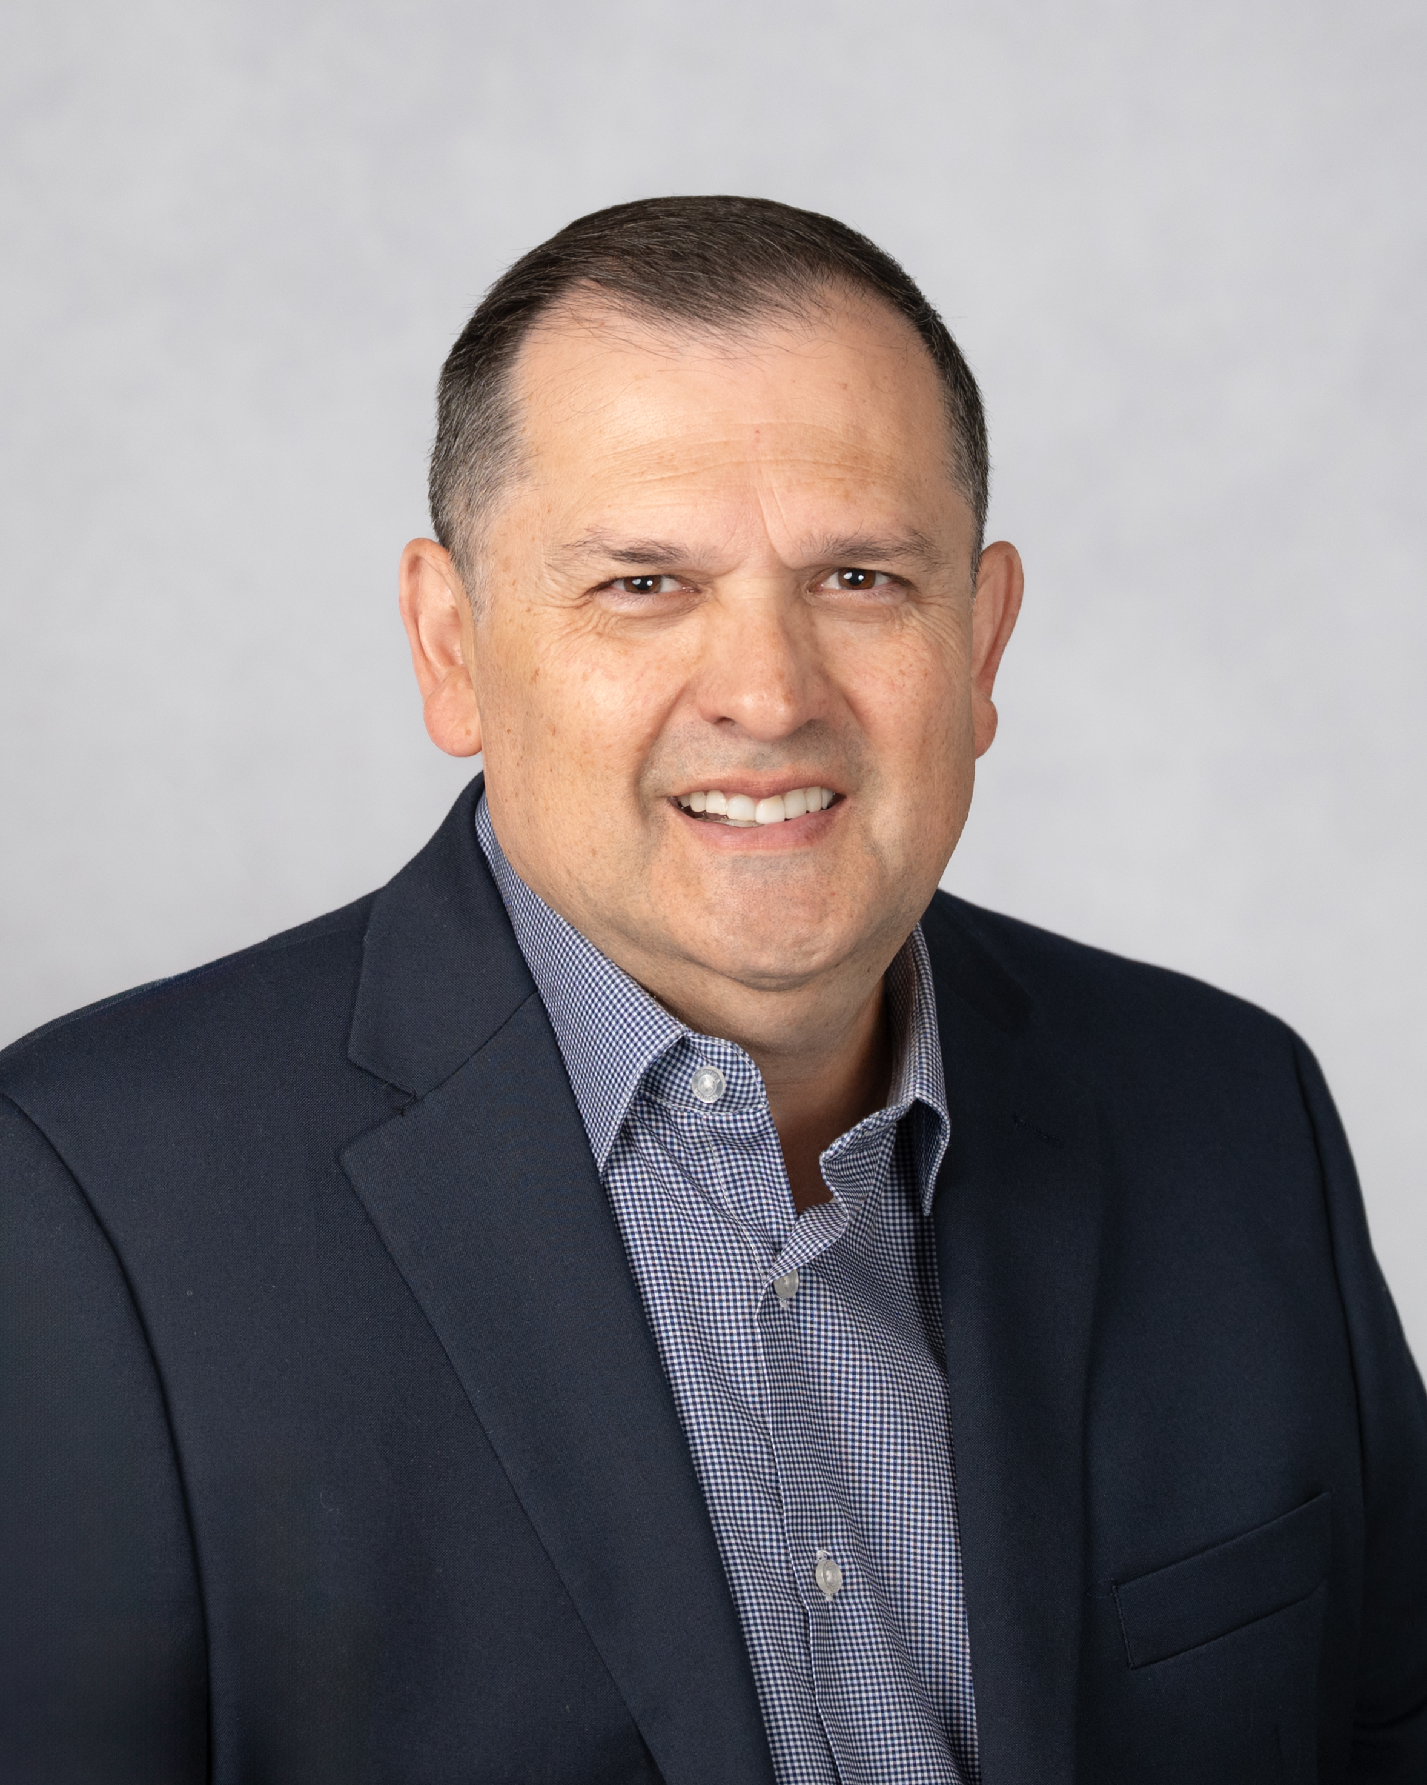
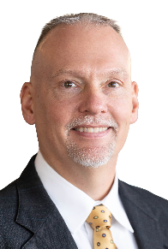
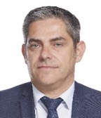
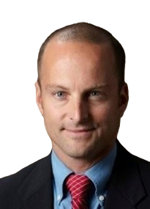

The Engines
Leadership Team
Massimiliano Bonanni
GM - Product
Strategy, Engines
Alok Kumar
Director Sales & Service, Engines India
Nino De Giglio
Director Mktg Comms & Channel Mgmt., Engines
Shaoqi Li
Commercial Director Engines China & ASPAC
Chris Rector
Director Aftermarket Service & Support, Engines
Eduardo Montero
VP-Sales & Latin America,
Engines Americas
Dave Finch
Director Continuous Improvement, Engines
Eric Fontaine
President – Engines
Thierry Navarro
Director Sales,
Engines EMEA
Quinn Derby
Sr Mgr Product Marketing, Engines

Slide 15


Global manufacturing footprint
G A S O L I N E
Hattiesburg (Mississippi, US)
Built - 1997
Square Feet – 208,548
ISO 9001
D I E S E L
Reggio Emilia (Italy)
Built - 1963
Sq. Meters – 166,000
ISO 9001
ISO 50001
D I E S E L
Chhatrapati Sambhajinagar
Form. Aurangabad (India)
Built - 2002
Sq. Meters – 50,000
ISO 9001
ISO 14001
G A S O L I N E
Chongqing (China)
Build - 2007
Square Meters – 80,000
ISO 9001

Slide 16

Global presence
NA
USA, Kohler WI
EMEA
ITALY, Reggio Emilia
APAC
CHINA, Shanghai
APAC
INDIA, Pune
HEADQUARTERS
EUROPEAN SALES AND SERVICE OFFICES
Lyon
FRANCE
Rubí, Barcelona SPAIN
Neu-Isenburg GERMANY
Hook
UK

Slide 17

The value of Rehlko

Slide 18
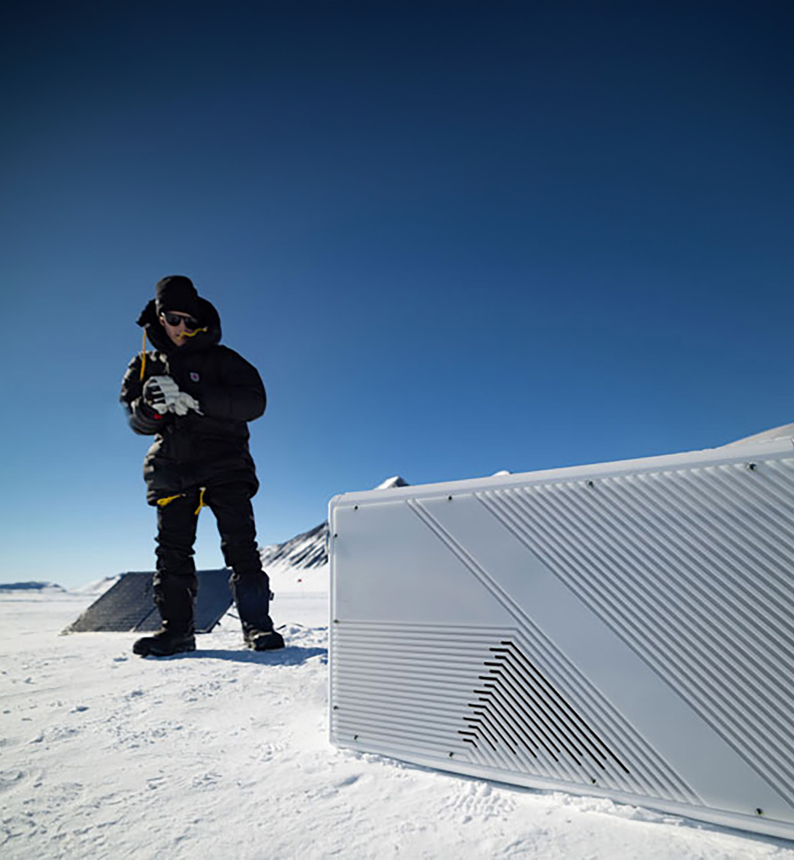
Legendary performance
WHAT WE DO
For over 100 years, Rehlko has been driven by the passion and dedication of our people, crafting high-performance engines that empower our clients to succeed.
Our longevity and commitment ensure that customers can rely on our expertise with confidence.

Slide 19

Focus on the customer
WHAT WE DO
We prioritize delivering exceptional support through prompt action and teamwork.
By aligning with customer needs, we provide engineering assistance, from machine development and integration to service support, acting as a trusted, non-competing partner to drive success.

Slide 20

Meaningful product value
WHAT YOU GET
Complete range of fuel-efficient diesel, gasoline and new low-emission solutions as hybrid, synthetic and alternate fuels as HVO, hydrogen, natural gas and propane engines up to 100 kW.
Products that get the job done quicker, easier, and more efficiently resulting in more revenue and reduced TCO.
High product regulatory compliance integrity.

Slide 21
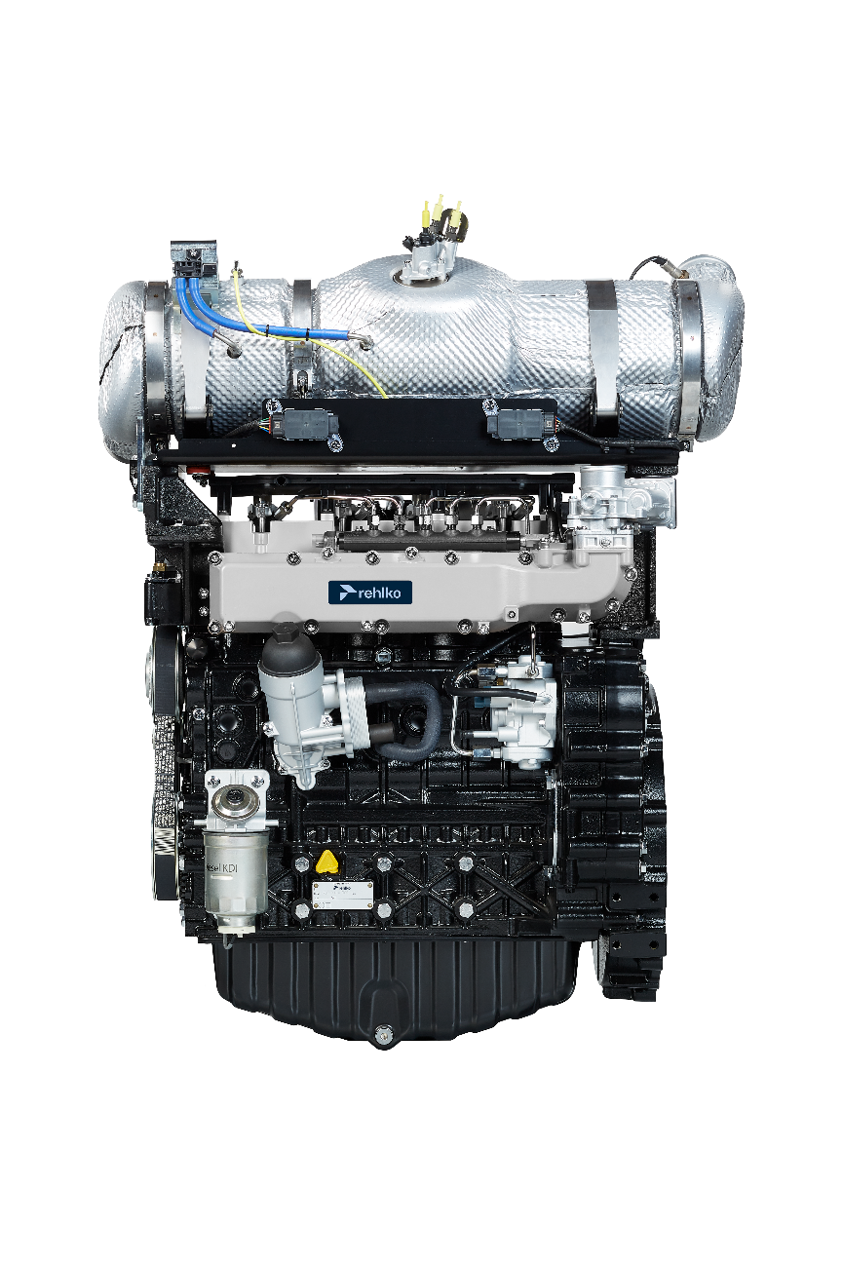

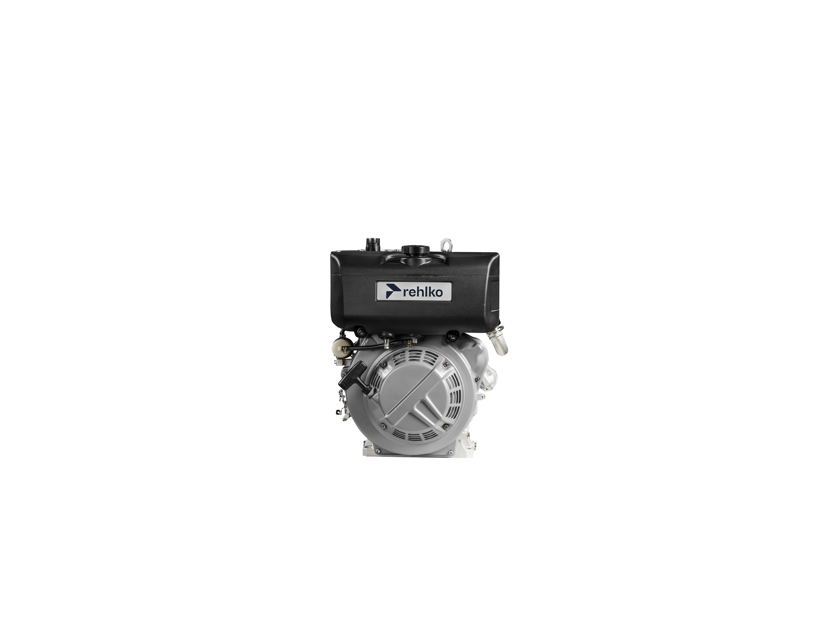
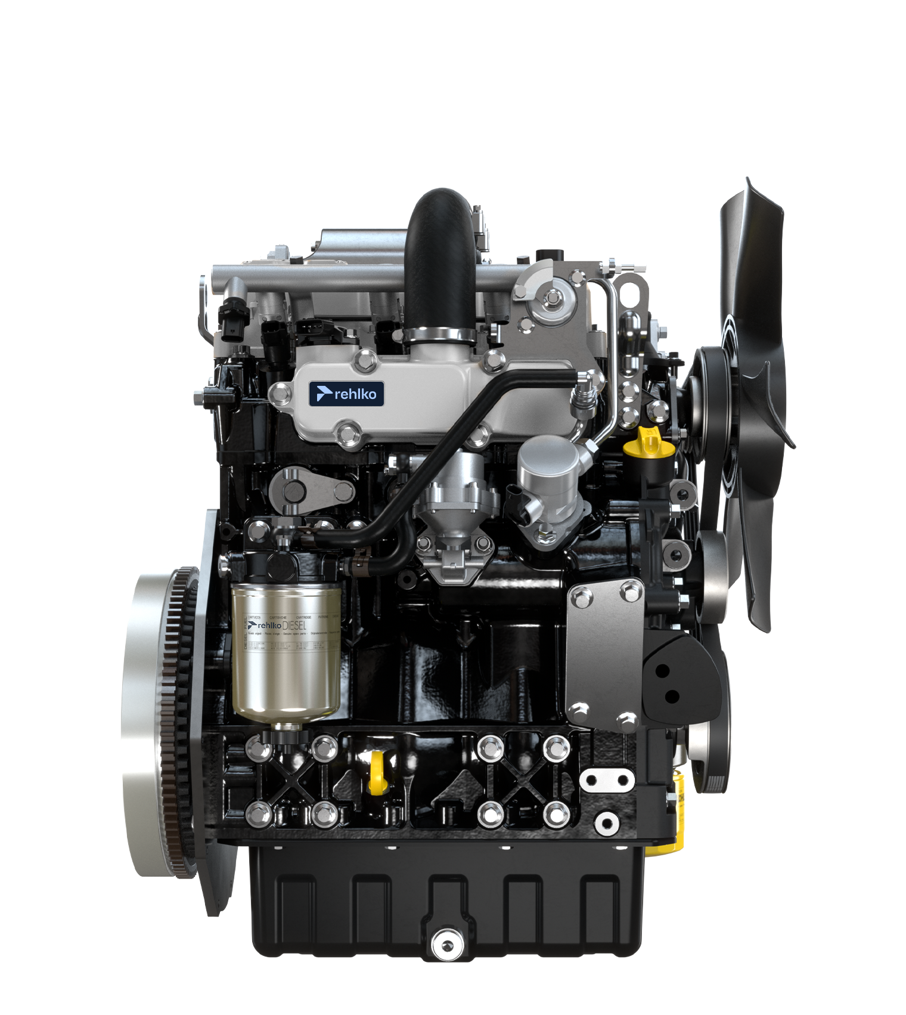
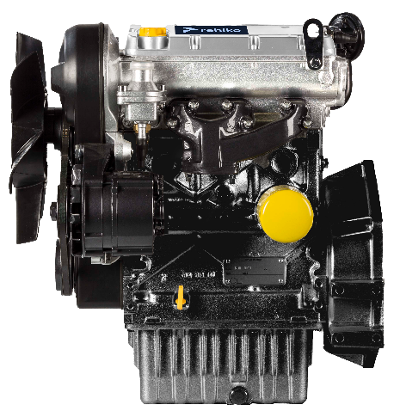
Diesel range
Horizontal Shaft
UP TO
112 kW
FAMILY
KD
KDW
KSD
KDI
DISPLACEMENT
224 -1248
686 -1372
1391
1861 – 3357
POWER
3 – 18 kW
6 – 24 kW
18,9 kW
31 – 112 kW
PEAK TORQUE
10.4 – 67 Nm
35 – 78 Nm
90 – 120 Nm
133 – 650 Nm
MAIN BENEFITS
High power density
Compactness
Electronic injection
Electronic Injection
Fuel efficiency
Low noise
Best-in-class torque density
Smart aftertreatment system

Slide 22
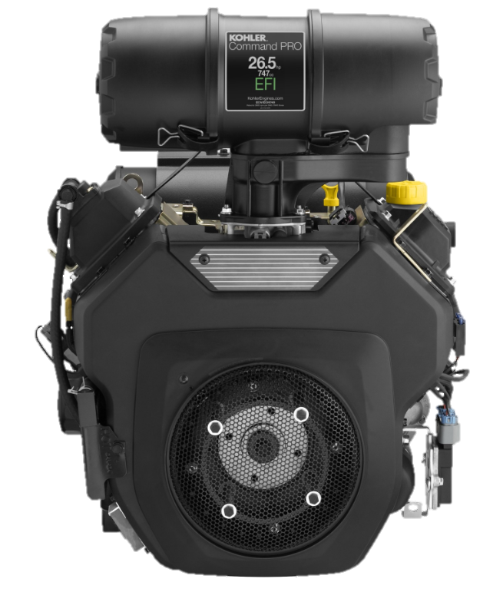
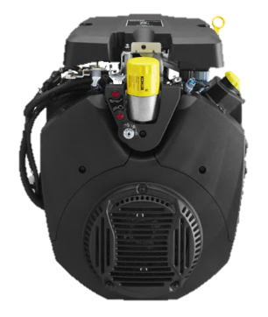
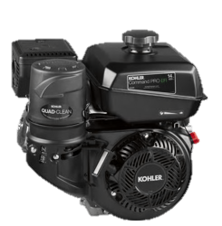
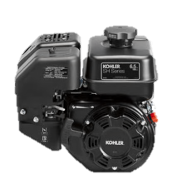
Gasoline range
Horizontal Shaft
UP TO
38 hp
FAMILY
SH Series
Command PRO
Command PRO
Command PRO
DISPLACEMENT
208 cc
177 – 429 cc
674 – 747 cc
999 cc
POWER
6.5 hp
5.5 – 14 hp
19 – 26.5 hp
32.5 – 38 hp
PEAK TORQUE
10.2 (13.8)
ft-lb (Nm)
7.2 (9.8) – 8.3 (11.2)
ft-lb (Nm)
35.0 (47.5) – 42.2 (57.2)
ft-lb (Nm)
53.5 (71.8) – 57.4 (77.8)
ft-lb (Nm)
MAIN BENEFITS
Fuel Secure™
Fuel Secure™
Electronic Fuel Injection
Electronic Fuel Injection
Quad Clean™ air filtration
Electronic Throttle Control
Electronic Fuel Injection on ECH440 model

Slide 23
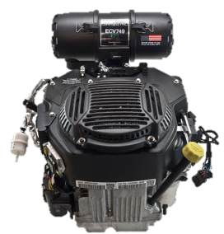
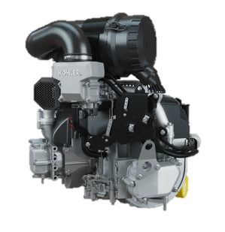
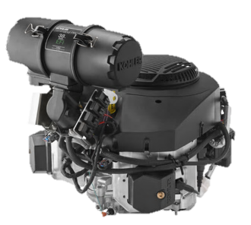
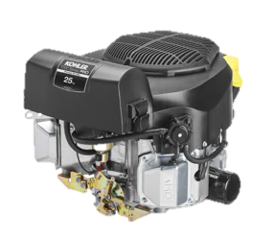
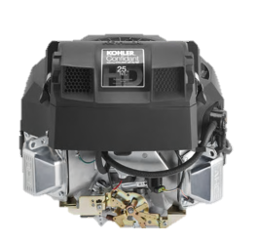
Gasoline range
Vertical Shaft – Twin Cyl
UP TO
38 hp
FAMILY
7000 Series
Confidant
Command PRO
Command PRO
Command PRO
DISPLACEMENT
747 cc
747 cc
747 cc
888 cc
999 cc
POWER
20 – 26 hp
23 – 27 hp
23 – 26.5 hp
29 – 32 hp
35 – 38 hp
PEAK TORQUE
40.3 (54.6)
ft-lb (Nm)
40.9 (55.5)- 42.4 (57.5)
ft-lb (Nm)
39.1 (51.7) – 40.9 (54.2)
ft-lb (Nm)
53.1 (72.0)
ft-lb (Nm)
53.0 (71.8) – 56.9 (77.2)
ft-lb (Nm)
MAIN BENEFITS
Smart Choke™
PRO Filtration
Electronic Fuel Injection
6” Air Cleaner
Electronic Fuel Injection
PRO Filtration
Electronic Fuel Injection
Electronic Throttle Control
Electronic Fuel Injection

Slide 24
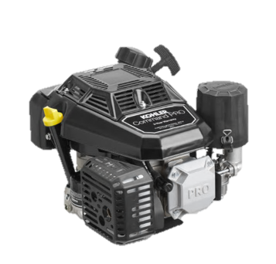
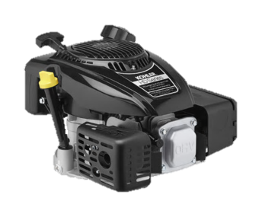
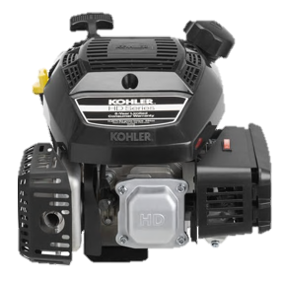
Gasoline range
Vertical Shaft – Single Cyl
UP TO
11 ft - lb
FAMILY
XTX Series
HD Series
Command PRO
DISPLACEMENT
149 – 173 cc
149 – 224 cc
173 – 224 cc
GROSS TORQUE
6.5 – 7.75 ft-lb
6.75 – 11 ft-lb
7.75 – 11 ft-lb
MAIN BENEFITS
Accu-Fill™
Accu-Fill™
Accu-Fill™
Smart Choke™
Smart Choke™
Quad Clean™ air filtration
Full-pressure oil filtration

Slide 25
Worldclass global support
WHAT YOU GET
Tested genuine parts to guarantee best performance and make the most out of your machine.
Trained experts ready to support you.
Over 2,000 distributors and 8,000 service dealers worldwide.

Slide 26

Operational excellence
How we deliver
  We align with a system that prioritizes:
  Safety
  People
  Quality
  Delivery
  Cost

Slide 27
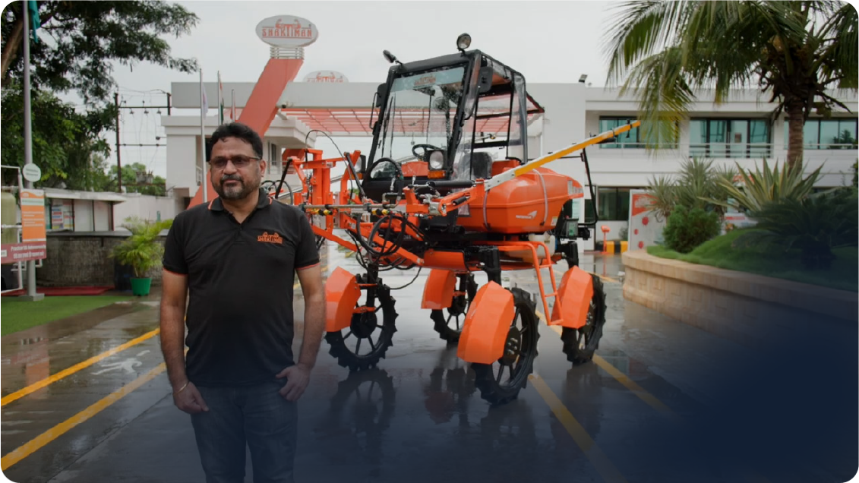
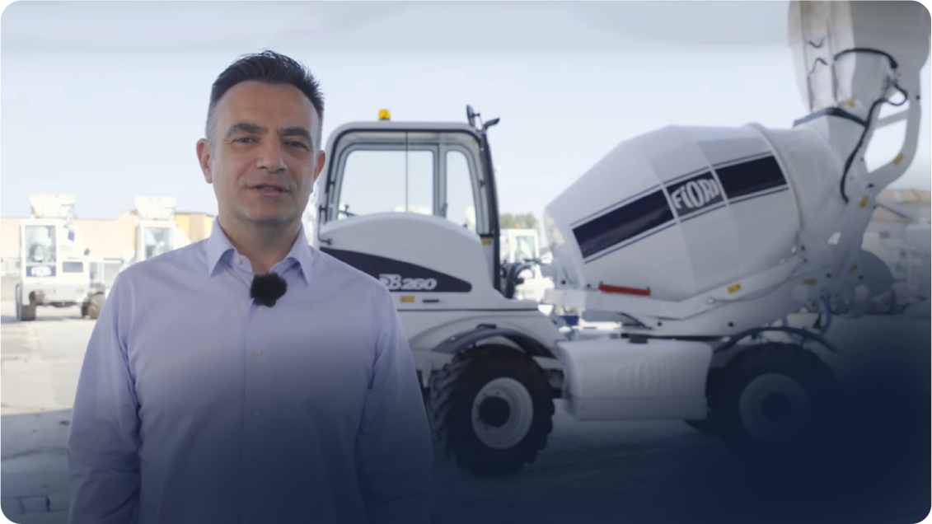
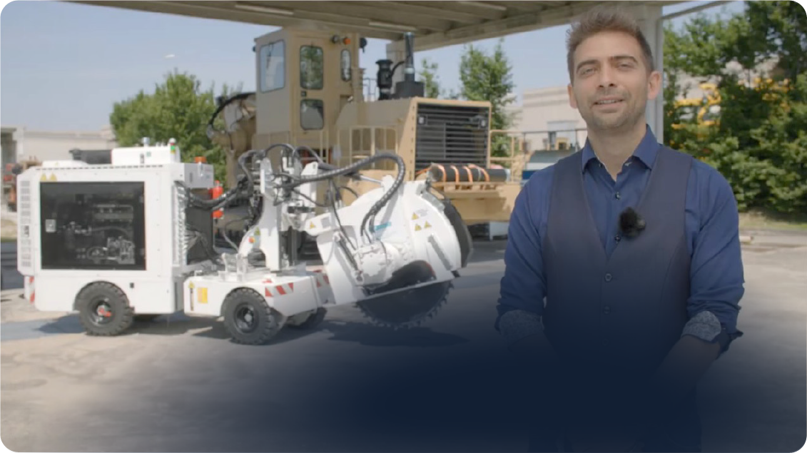
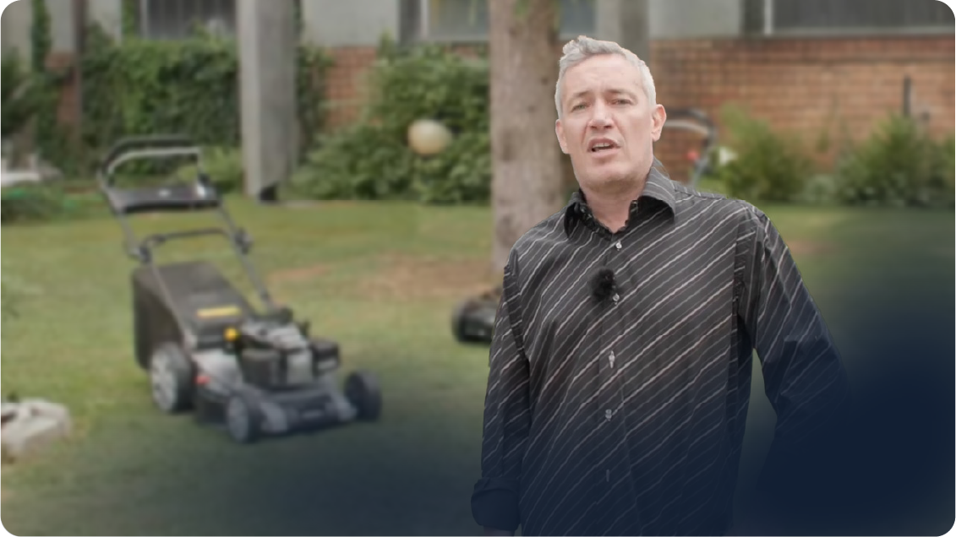
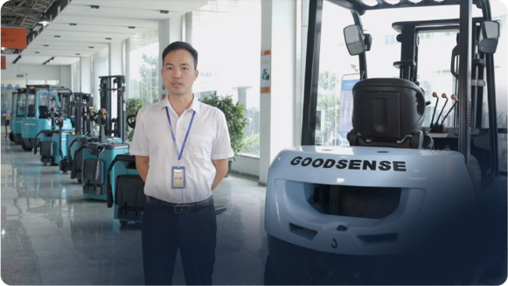
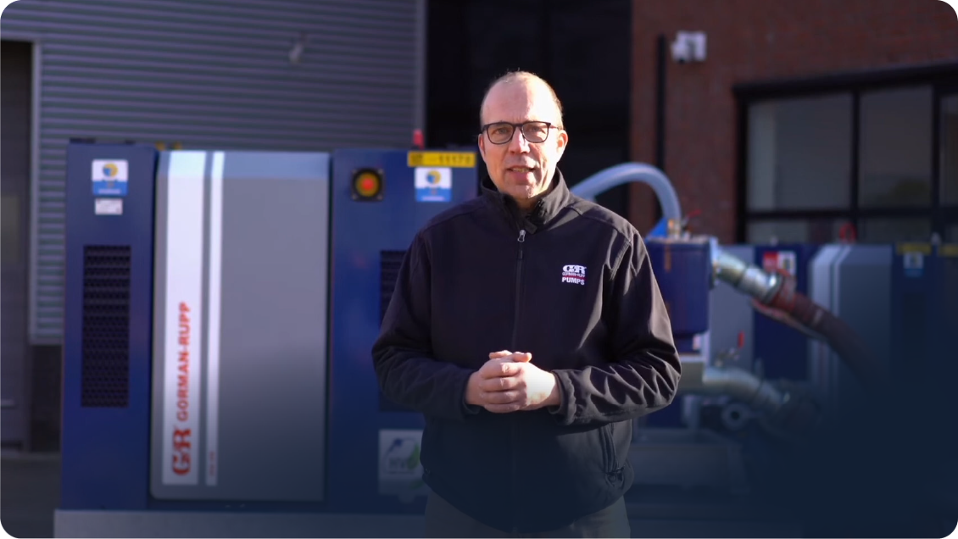
Our best testimonials:
our customers

Slide 28

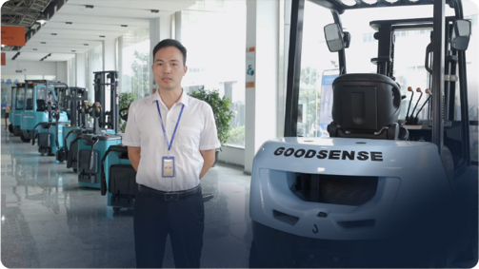
The voice of our customers
Product quality
Operational Flexibility
Compact engines
Shaktiman
Tesmec
Fiori Group
Cost-effectiveness
Aftersales value
Reliable partners
Goodsense
Gorman Rupp
Ma.Ri.Na system

Slide 29
Thank you for your attention

Slide 30



